Slide 1
Welcome to Computer Science!

Slide 2
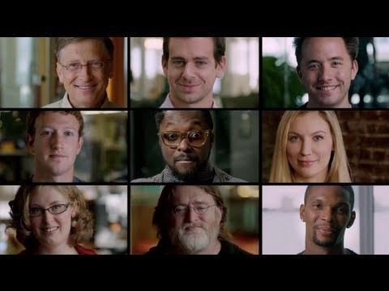
Computer Science is everywhere!

Slide 3
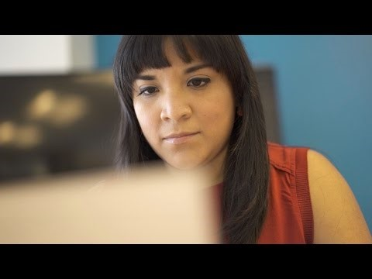
Why Computer Science matters!

Slide 4
What is computer science?
Computer Programming
Hardware & Software
Information Processing
The study of computers and how they can be used to solve problems

Slide 5
What is computer programming?
Program-set of instructions that the computer will follow.
Programming Language-tools that computer scientists use to write programs.
Examples: Scratch, Java, C++

Slide 6
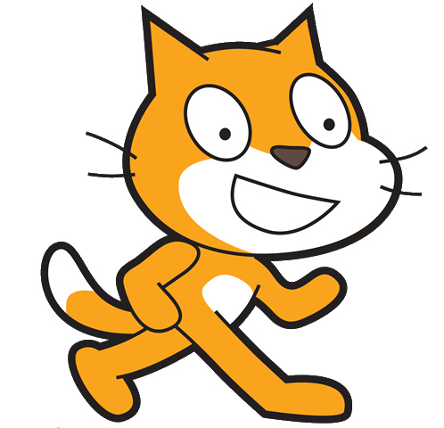
Scratch Terminology
Sprite-a two-dimensional character or object
Stage- where the sprites interact with one another and the user
Costume-change the appearance of a sprite
Block-tell the sprite what to do

Slide 7
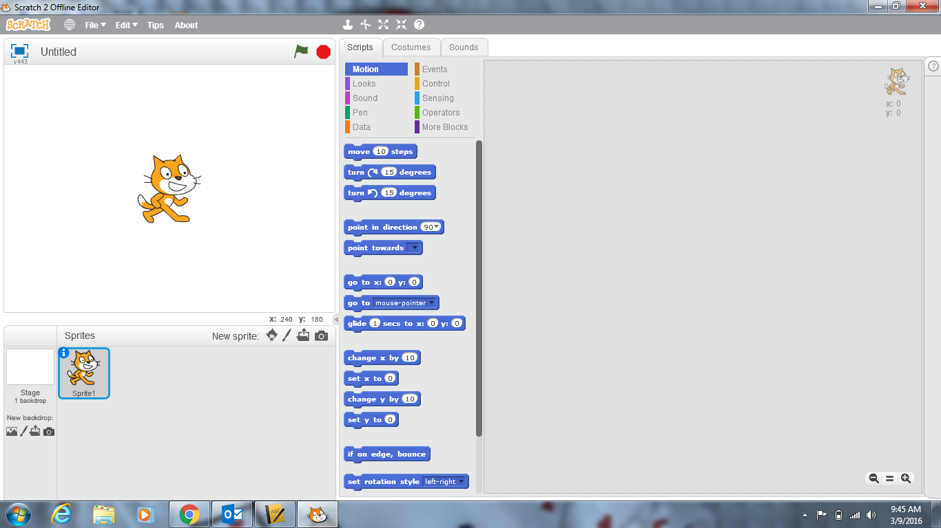
1.Menu Bar
2. Toolbar
3. Execute Buttons
4. Stage
5. Mouse Coordinates
6. New Sprite Buttons
7. Blocks Palette
8. Scripts Area

Slide 8
Let’s write the program for a Dancing Cat!
Double-click on the Scratch 2 icon on your desktop.
If it asks you to update, please click “Later” or “Ignore”

Slide 9
Computer Science is the study of ___________ and how they can be used to ________________________.
computers
solve problems.
Today we ________________ a program to make a cat dance.
We used Scratch as our _____________________ ________________________.
wrote
programming
language

Slide 10
Code.org Introduction to Block Programming
On the class website, click on the link for the code.org introductory lessons.
In the upper right hand corner, click “SIGN IN”
When creating your account, be sure to use the following: Username: PTSDWebapps email Password: 220#
Be sure to enter the Classroom Code below:
Period 4/5: TRSIVS
Period 9: AYHRGF
Period 10: RKTNLG
Skip all of the UNPLUGGED Activities; only complete the PUZZLES!

